Slide 1
Unit 5 NETWORK connectivity

Slide 2
Network Programming
Python provides two levels of access to network services. At a low level, you can access the basic socket support in the underlying operating system, which allows you to implement clients and servers for both connection-oriented and connectionless protocols.
Python also has libraries that provide higher-level access to specific application-level network protocols, such as FTP, HTTP, and so on.

Slide 3
What ARE Sockets?
Sockets are the endpoints of a bidirectional communications channel. Sockets may communicate within a process, between processes on the same machine, or between processes on different continents.
Sockets may be implemented over a number of different channel types: Unix domain sockets, TCP, UDP, and so on. The socket library provides specific classes for handling the common transports as well as a generic interface for handling the rest.

Slide 4
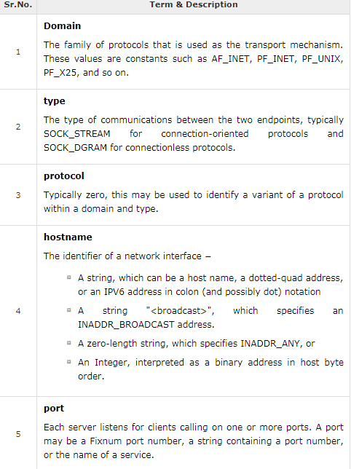

Slide 5
The socket Module
To create a socket, you must use the socket.socket() function available in socket module, which has the general syntax −
Here is the description of the parameters −
socket_family − This is either AF_UNIX or AF_INET, as explained earlier.
socket_type − This is either SOCK_STREAM or SOCK_DGRAM.
protocol − This is usually left out, defaulting to 0.
s = socket.socket (socket_family, socket_type, protocol=0)

Slide 6
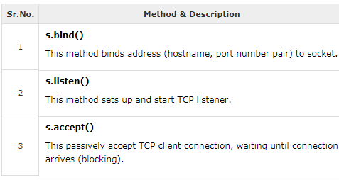
Server Socket Methods

Slide 7
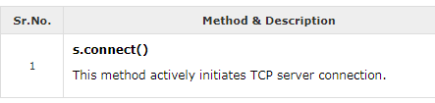
Client Socket Methods

Slide 8
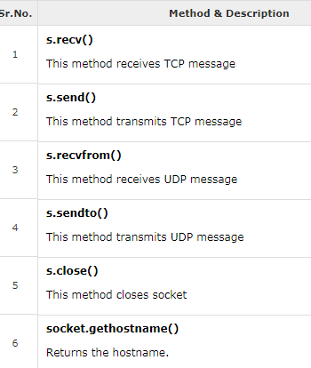
General Socket Methods

Slide 9
A Simple Server
To write Internet servers, we use the socket function available in socket module to create a socket object. A socket object is then used to call other functions to setup a socket server.
Now call bind(hostname, port) function to specify a port for your service on the given host.
Next, call the accept method of the returned object. This method waits until a client connects to the port you specified, and then returns a connection object that represents the connection to that client.

Slide 10
#This is server.py file
import socket
# create a socket object
serversocket = socket.socket(socket.AF_INET, socket.SOCK_STREAM)
# get local machine name
host = socket.gethostname()
print(host)
port = 9999
# bind to the port
serversocket.bind((host, port))
# queue up to 5 requests
serversocket.listen(5)
while True:
# establish a connection
clientsocket,addr = serversocket.accept()
print("Got a connection from %s" % str(addr))
msg = 'Thank you for connecting'+ "\r\n"
clientsocket.send(msg.encode('ascii'))
clientsocket.close()

Slide 11
A Simple Client
Let us write a very simple client program which opens a connection to a given port 12345 and given host. This is very simple to create a socket client using Python's socket module function.
The socket.connect(hosname, port ) opens a TCP connection to hostnameon the port. Once you have a socket open, you can read from it like any IO object. When done, remember to close it, as you would close a file.
The following code is a very simple client that connects to a given host and port, reads any available data from the socket, and then exits −

Slide 12
#!/usr/bin/python3 # This is client.py file
import socket
# create a socket object
s = socket.socket(socket.AF_INET, socket.SOCK_STREAM)
# get local machine name
host = socket.gethostname()
print(host)
port = 9999
# connection to hostname on the port.
s.connect((host, port))
# Receive no more than 1024 bytes
msg = s.recv(1024)
s.close()
print (msg.decode('ascii'))

Slide 13
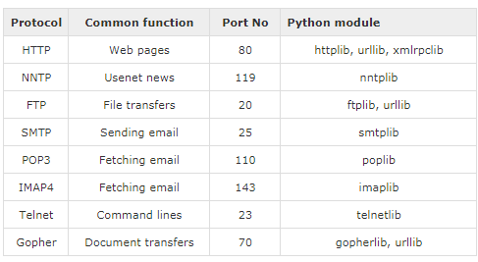
Python Internet modules
A list of some important modules in Python Network/Internet programming.

Slide 14
Email
import smtplib
content='hello,sending mail from python code'
mail=smtplib.SMTP('smtp.gmail.com',587)
mail.ehlo()
mail.starttls()
mail.login('mani.manila@gmail.com','password')
mail.sendmail('mani.manila@gmail.com','rushikvadher@gmail.com',content)
mail.close()

Slide 15
Attachment in mail
import smtplib
from email.mime.multipart import MIMEMultipart
from email.mime.text import MIMEText
from email.mime.base import MIMEBase
from email import encoders
#MIME (Multi-Purpose Internet Mail Extensions)
fromaddr = "mani.manila@gmail.com"
toaddr = "rushikvadher@gmail.com"
# instance of MIMEMultipart
msg = MIMEMultipart()
# storing the senders email address
msg['From'] = fromaddr
# storing the receivers email address
msg['To'] = toaddr
# storing the subject
msg['Subject'] = "Subject of the Mail"

Slide 16
# string to store the body of the mail
body = "Body_of_the_mail"
# attach the body with the msg instance
msg.attach(MIMEText(body, 'plain'))
# open the file to be sent
filename = "abc.txt"
attachment = open("abc.txt", "rb")
# instance of MIMEBase and named as p
p = MIMEBase('application', 'octet-stream')
# To change the payload into encoded form
p.set_payload((attachment).read())
# encode into base64
encoders.encode_base64(p)

Slide 17
p.add_header('Content-Disposition', "attachment; filename= %s" % filename)
# attach the instance 'p' to instance 'msg'
msg.attach(p)
# creates SMTP session
s = smtplib.SMTP('smtp.gmail.com', 587)
# start TLS for security
s.starttls()
# Authentication
s.login(fromaddr, "Password_of_the_sender")
# Converts the Multipart msg into a string
text = msg.as_string()
# sending the mail
s.sendmail(fromaddr, toaddr, text)
# terminating the session
s.quit()

Slide 18
Steps to send mail with Attachments from Gmail account:
For adding an attachment, you need to import:
import smtplib
from email.mime.multipart import MIMEMultipart
from email.mime.text import MIMEText
from email.mime.base import MIMEBase
from email import encoders
These are some libraries which will make our work simple. These are the native libraries and you dont need to import any external library for this.
Firstly, create an instance of MIMEMultipart, namely “msg” to begin with.
Mention the sender’s email id, receiver’s email id and the subject in the “From”, “To” and “Subject” key of the created instance “msg”.
In a string, write the body of the message you want to send, namely body. Now, attach the body with the instance msg using attach function.
Open the file you wish to attach in the “rb” mode. Then create an instance of MIMEBase with two parameters. First one is ‘_maintype’ amd the other one is ‘_subtype’. This is the base class for all the MIME-specific sub-classes of Message. Note that ‘_maintype’ is the Content-Type major type (e.g. text or image), and ‘_subtype’ is the Content-Type minor type (e.g. plain or gif or other media).
set_payload is used to change the payload the encoded form. Encode it in encode_base64. And finally attach the file with the MIMEMultipart created instance msg.
After finishing up these steps, follow the instructions described in the previous article to create a session, secure it and check the authenticity and then after sending the mail, terminate the session.

Slide 19
Reading from url
import urllib.request
# open a connection to a URL using urllib
webUrl = urllib.request.urlopen('https://wordpress.org/plugins/about/readme.txt')
#get the result code and print it
print ("result code: " + str(webUrl.getcode()))
# read the data from the URL and print it
data = webUrl.read()
print (data)

Slide 20
How to Open URL using Urllib
Before we run the code to connect to Internet data, we need to import statement for URL library module or "urllib".
Import urllib
Define your main function
Declare the variable webUrl
Then call the urlopen function on the URL lib library
The URL we are opening is guru99 tutorial on youtube
Next, we going to print the result code
Result code is retrieved by calling the getcode function on the webUrl variable we have created
We going to convert that to a string, so that it can be concatenated with our string "result code"
This will be a regular HTTP code "200", indicating http request is processed successfully

Slide 21
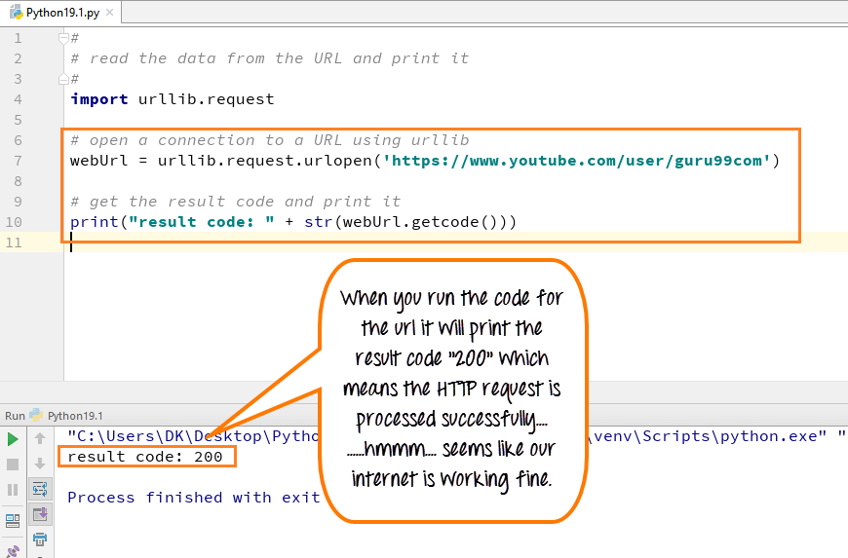

Slide 22
How to get HTML file form URL in Python
You can also read the HTML file by using the "read function" in Python, and when you run the code, the HTML file will appear in the console.
Call the read function on the webURL variable
Read variable allows to read the contents of data files
Read the entire content of the URL into a variable called data
Run the code- It will print the data into HTML format

Slide 23
